Slide 1
and Improving Your Hospital’s Workflow & Net Income
Replace with Hospital Logo
(then delete this box)
Advancing Patient Healing
Presenter: [Name]
Date: [MM/DD/YYYY]
ML302-A

Slide 2
[hospital name]
Presentation Outline
The science and evidence of Retained Blood
PleuraFlow designed to reduce Retained Blood
Analysis of the burden of Retained Blood on [Hospital Name]
Proposal and cost benefit for [Hospital Name]

Slide 3
The Science & Evidence of
Retained Blood After Cardiac Surgery

Slide 4
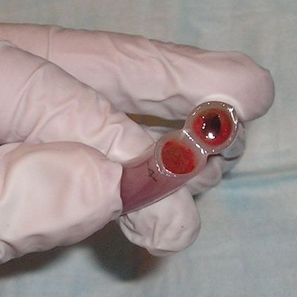
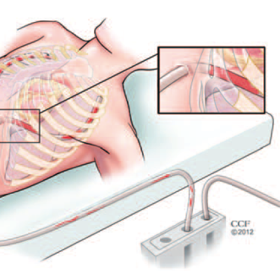
ALL CHEST TUBES OCCLUDE
36%
86%
of cardiac surgery patients have one or more completely occluded chest tubes
of occlusions are inside the chest where they cannot be seen at the bedside
Current methods of addressing chest tube occlusions, such as milking or stripping are ineffective and potentially harmful.

Slide 5
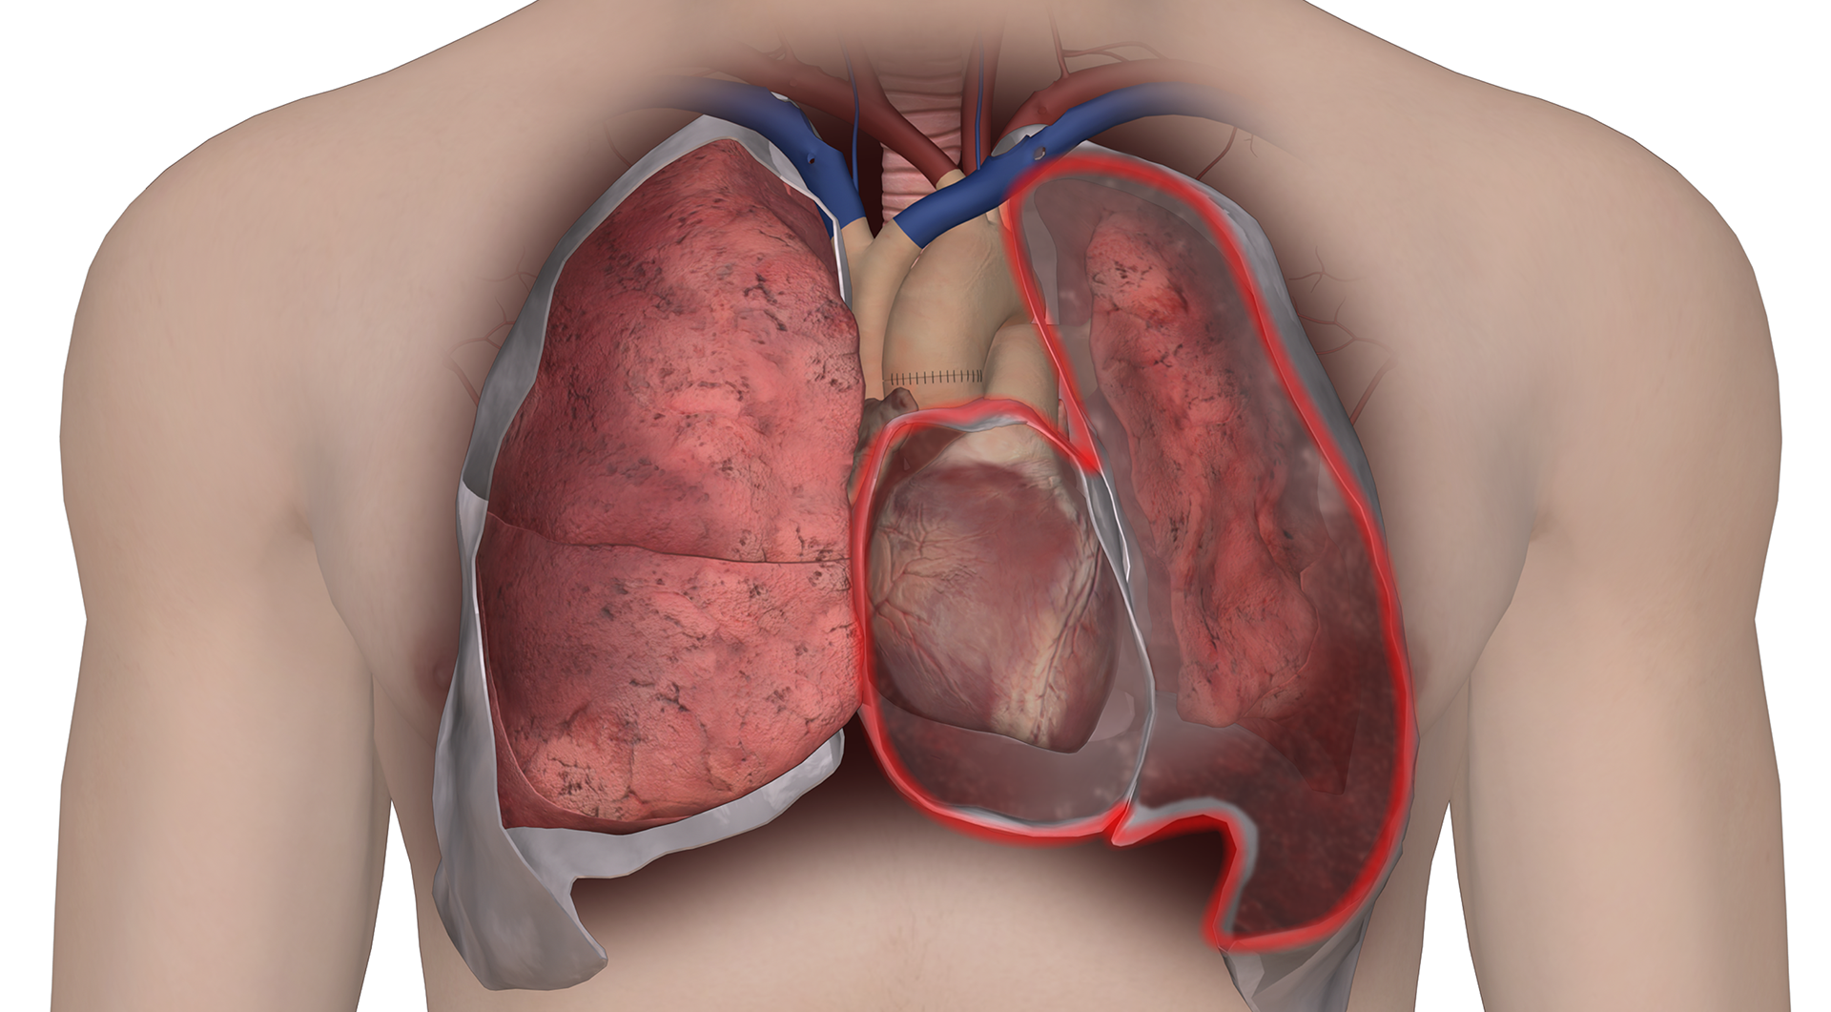
RETAINED BLOOD RE-INTERVENTIONS
Thoracentesis:
Pleural Effusion
20%
Pericardiocentesis:
Pericardial Effusion
of cardiac surgery patients require re-interventions due to Retained Blood
Insertion of Intercostal Drainage Catheter:
Hemothorax
Re-exploration for Bleeding:
Pericardial Tamponade
Notes:
Talking point is defining RB here in explaining how we get to the 20%.
Retained Blood Syndrome (RBS) – the composite of drainage-related post-cardiothoracic surgery complications that requires some type of reintervention, which is identified via ICD10 codes.

Slide 6
INCREASED morbidity and mortality risk
Patients with Retained Blood
186%
Patients without Retained Blood
162%
LONGER ICU LENGTH OF STAY
INCREASE IN INFECTIONS
122%
106%
INCREASE IN
30-DAY READMISSIONS
INCREASE IN MORTALITY
36%
39%
HIGHER INCIDENCE OF POAF*
INCREASE IN VENTILATION TIME
Data from MarketScan® PIDB and Commercial Medicare Databases July 1, 2012 - June 30, 2013.
*Retained Blood has been shown to contribute to the occurrence of post operative atrial fibrillation (POAF). These studies showed a reduction in POAF which correlated with a reduction in retained blood in patients. These findings suggest that use of PleuraFlow can reduce retained blood, which may contribute to reduced risk of POAF in some patients. Studies include both retrospective observational assessments and prospective trials, supported by ClearFlow. Results could be impacted by variations in study methodologies, institutional protocols used in treating patients, and other factors. ClearFlow products are not therapeutic devices. Please see full publications at www.clearflow.com for additional information.
Notes:
all complications increase
make a point to emphasize POAF because that is the next slide.

Slide 7

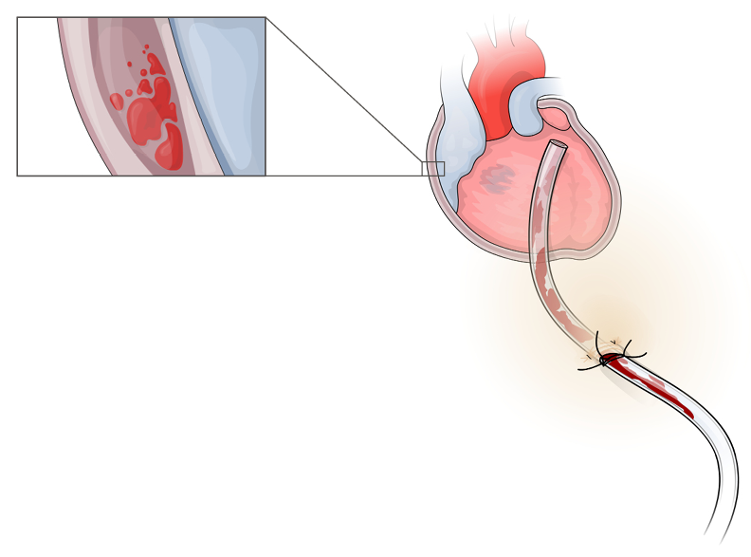
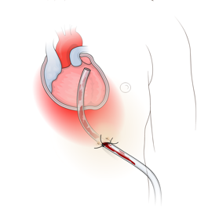

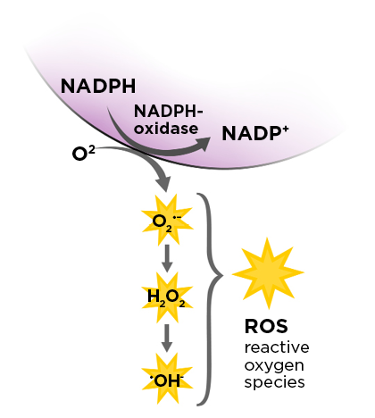
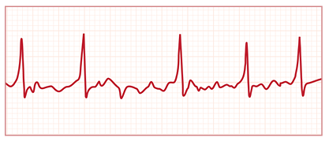
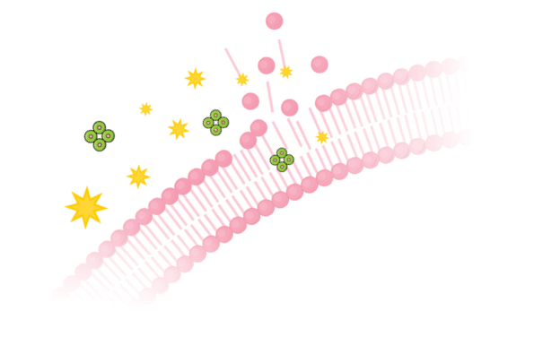
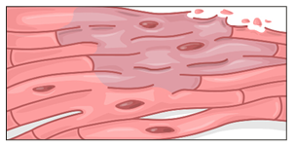

RETAINED BLOOD INFLAMMATION CAN TRIGGER POAF
Clogged drain tube leads to Retained Blood at surgery site.
This leads to inflammation and tissue damage at surgery site.
Kramer, P.A., Melby, S.J., et al. Hemoglobin-associated oxidative stress in the pericardial compartment of postoperative cardiac surgery patients. Lab Invest. 2015;95(2):132-41.
Samuel St. Onge, MD, Louis P. Perrault, MD, PhD, Philippe Demers, MDMS Edward M. Boyle, MD, A. Marc Gillinov, MD, James Cox, MD, and Spencer Melby, MD. Pericardial Blood as a Trigger for Postoperative Atrial Fibrillation After Cardiac Surgery. Annals of Thoracic Surgery. 2018;105:321–8.

Slide 8
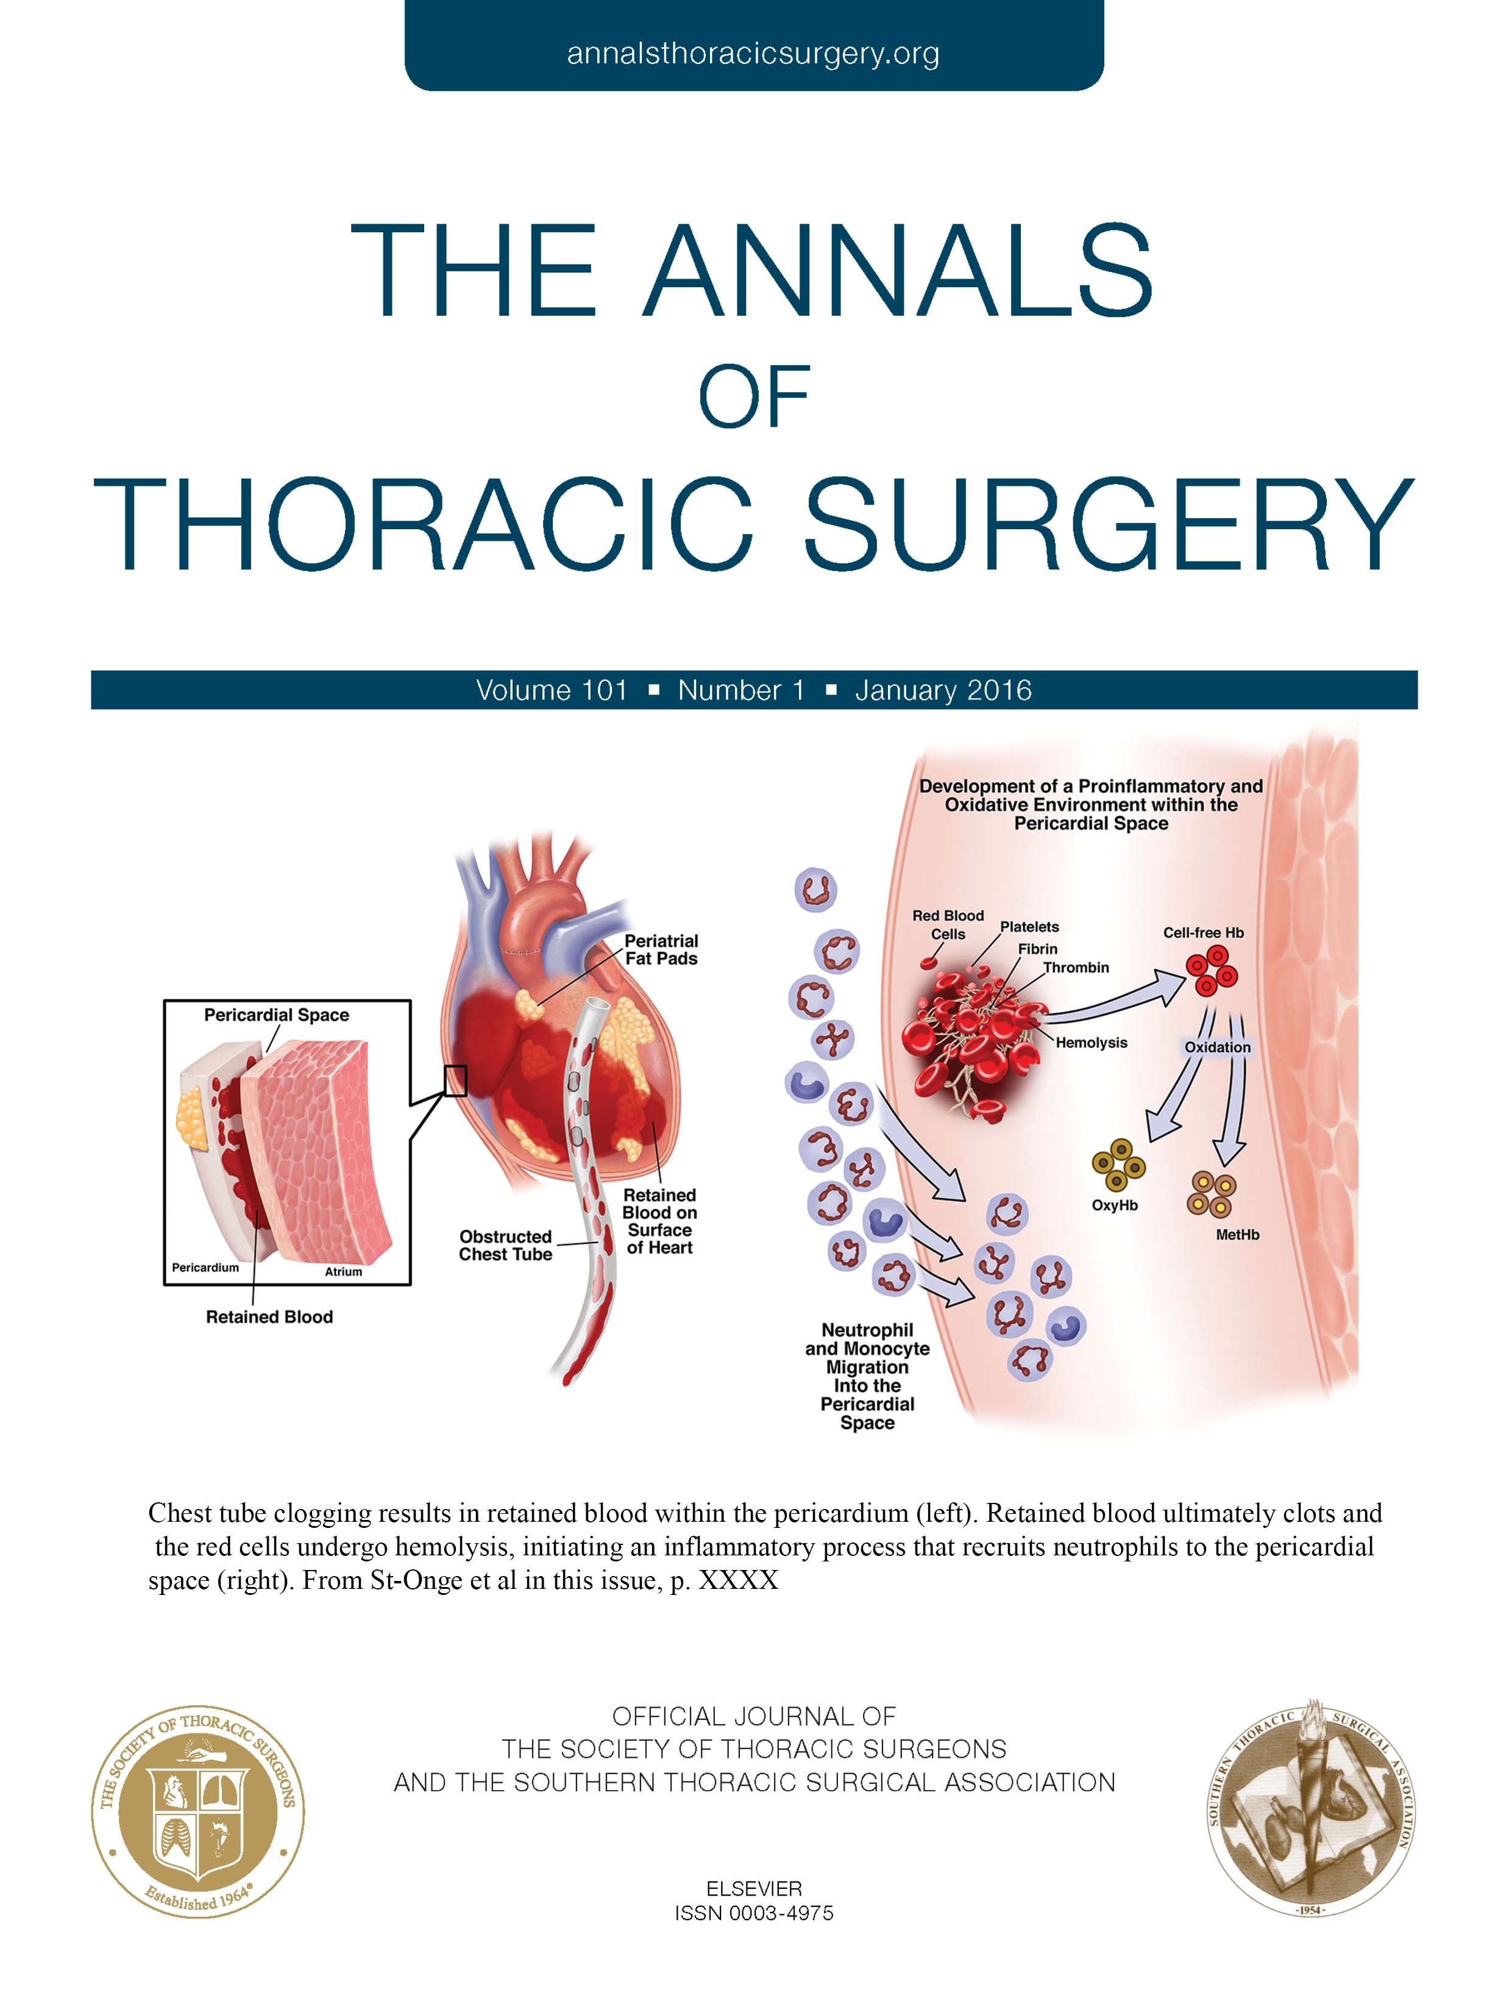
SCIENCE OF RETAINED BLOOD IS WELL ESTABLISHED
The Annals
January 2018
The Lancet
November 2021

Slide 9
MINIMIZING RETAINED BLOOD

Slide 10
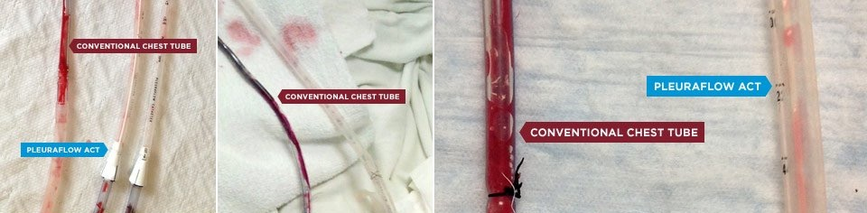
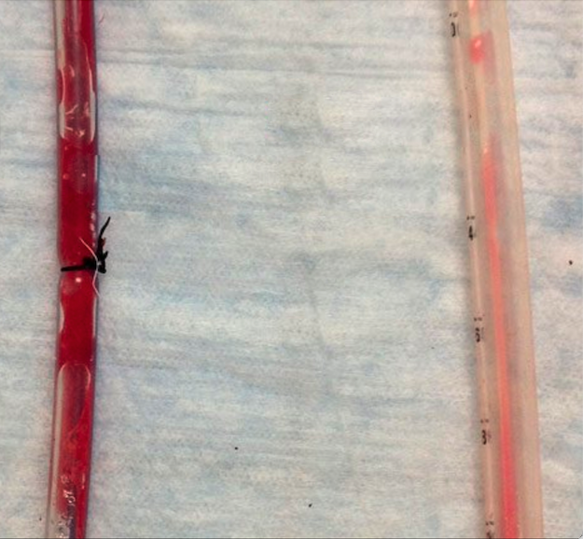
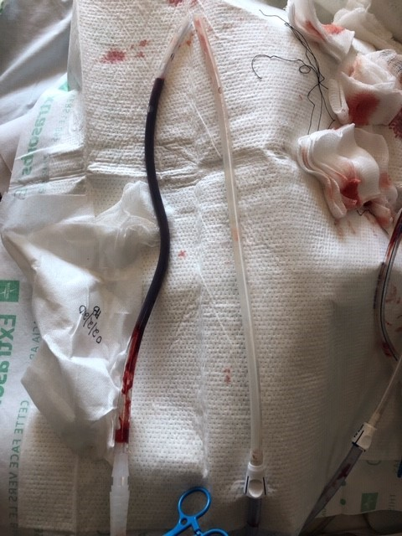
MAINTAINING CHEST TUBE PATENCY
PleuraFlow® Active Clearance Technology® (ACT) is designed to proactively remove clots formed inside the chest tube to prevent or minimize chest tube occlusion.
CONVENTIONAL DRAIN TUBE
PLEURAFLOW ACT
PLEURAFLOW ACT
CONVENTIONAL DRAIN TUBE
CONVENTIONAL DRAIN TUBE
PLEURAFLOW ACT
PLEURAFLOW ACT
CONVENTIONAL DRAIN TUBE
Examples of conventional drainage tubes and PleuraFlow ACT pulled from the same patient 24hr to 48hrs post surgery.

Slide 11
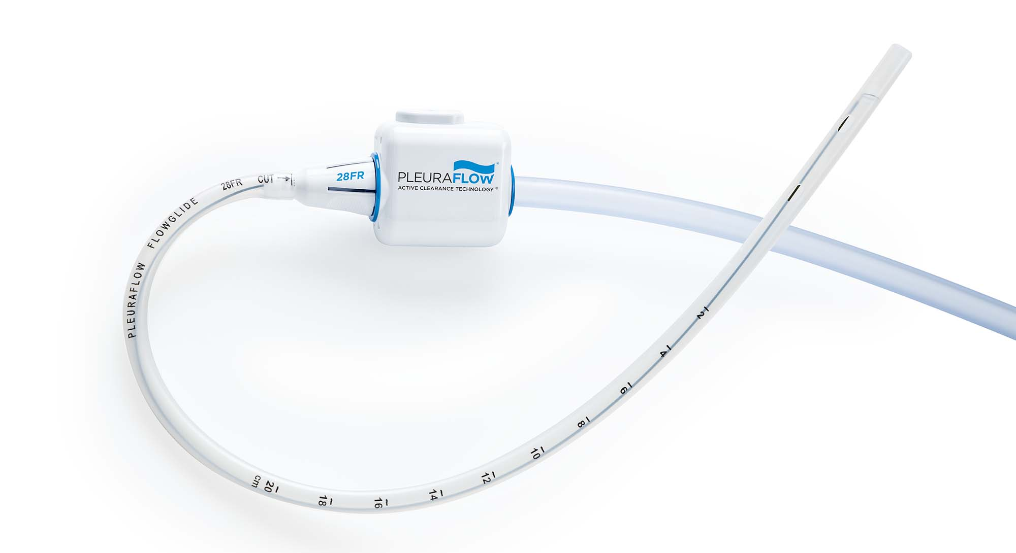
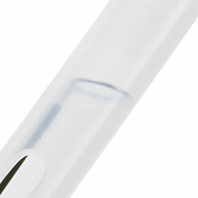
PLEURAFLOW® ACTIVE CLEARANCE TECHNOLOGY®
Clearance Wire & Loop
Maintains chest tube patency
Magnet Strength Button
Additional power on demand
Sophisticated New Magnetic Array
Designed to overcome the most stubborn occlusions
Guide Tube
Connects to any drainage canister

Slide 12

PLEURAFLOW® IN ACTION
Notes:
Will embed video once surrounding content more finalized. Don’t want to add to file size in the review process.

Slide 13
Randomized Controlled Trial Data
For patients treated with PleuraFlow the following results were observed*:
89% Reduction
in complete chest tube occlusions
(19% to 2%, p=0.01)
42% Reduction
of interventions for retained blood (10.6% to 6.2%, p=0.07)
18% Reduction
in Post Operative Atrial Fibrillation
(31% to 38%, p=0.08)
72% Reduction
in re-exploration for bleeding/cardiac tamponade
(5.7% to 1.6%, p=0.01)
* Results achieved with first generation PleuraFlow system.
St-Onge, et al. Active clearance vs conventional management of chest tubes after cardiac surgery: a randomized controlled study. Journal of Cardiothoracic Surgery. March 23, 2021. 16:44
Notes:
Speaker notes:
Randomized controlled study with a total of 520 patients, of which 257 had one PleuraFlow mediastinal chest tube placed and 263 had one standard mediastinal chest tube.

Slide 14
SUMMARY OF PEER-REVIEWED CLINICAL DATA*
Retained Blood
Sirch, et al: | 43% Reduction | JTCVS¹
St. Onge, et al: | 42% Reduction | JCTS³
Baribeau, et al: | 58% Reduction | JCTS²
Re-Exploration for Bleeding
Maltais, et al: | 65% Reduction | ASAIO⁶
Baribeau, et al: | 70% Reduction | JCTS²
St. Onge, et al: | 72% Reduction | JCTS³
Postoperative Atrial Fibrillation**
St. Onge, et al: | 18% Reduction | JCTS³
St. Onge, et al: | 31% Reduction | JTCVS⁴
Baribeau, et al: | 32% Reduction | JCTS²
Sirch, et al: | 33% Reduction | JTCVS¹
Length of Stay
St. Onge, et al: | 1 Day | JTCVS⁴
Baribeau, et al: | 1 Day | JCTS²
**Retained Blood has been shown to contribute to the occurrence of post operative atrial fibrillation (POAF). These studies showed a reduction in POAF which correlated with a reduction in retained blood in patients with PleuraFlow. These findings suggest that use of PleuraFlow can reduce retained blood, which may contribute to reduced risk of POAF in some patients.
1 – Sirch, et al J Thoracic & Cardiovascular Surgery
2 – Baribeau, et al J Cardiothoracic Surgery
3 – St. Onge, et al J Cardiothoracic Surgery
4 – St. Onge, et al J Thoracic & Cardiovascular Surgery
5 – Grieshaber, at al Annals of Thoracic Surgery
6 – Maltais, et al American Society for Artificial Internal Organs
*Studies include both retrospective observational assessments and prospective trials, supported by ClearFlow. Results could be impacted by variations in study methodologies, institutional protocols used in treating patients, and other factors. ClearFlow products are not therapeutic devices. Please see full publications at www.clearflow.com for additional information.

Slide 15
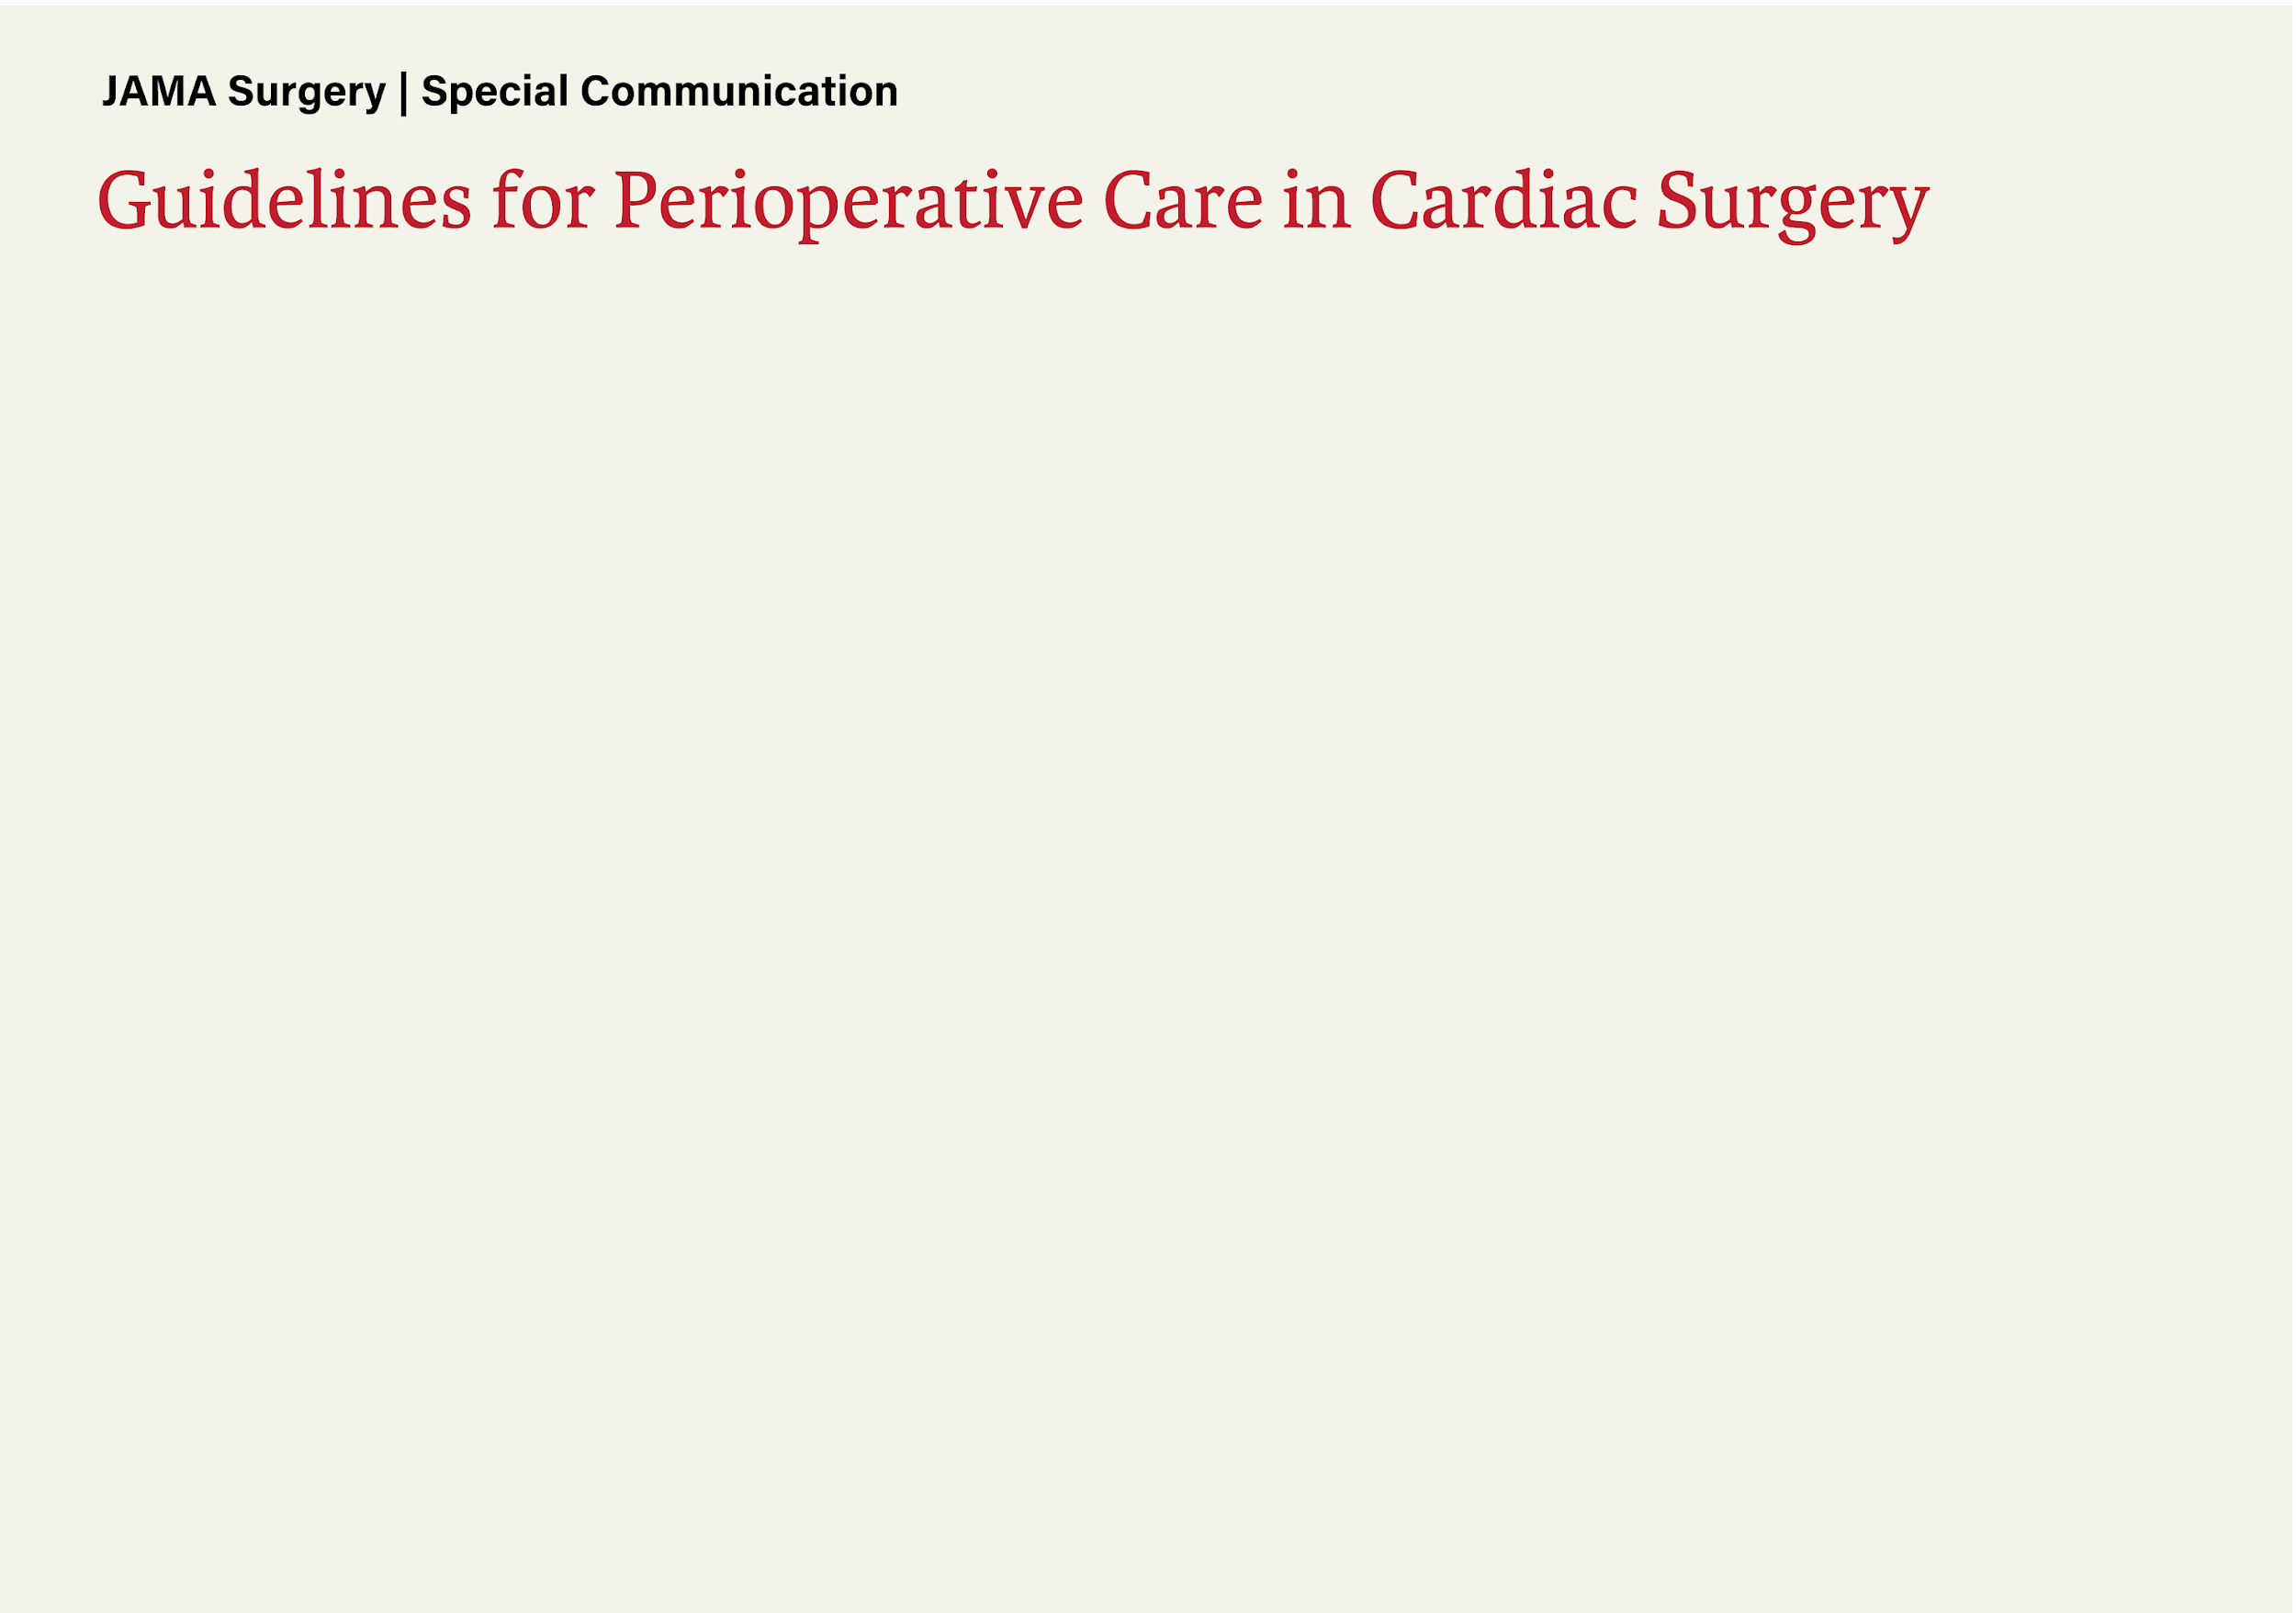
ERAS CARDIAC GUIDELINES
COR | LOE | RECOMMENDATIONS
I | A | Tranexamic acid or epsilon aminocaproic acid is recommended during on-pump cardiac surgical procedures.
I | B-R | Perioperative glycemic control is recommended.
I | B-R | A care bundle of evidenced based best practices is recommended to reduce surgical site infections.
I | B-R | Goal directed fluid therapy is recommended to reduce postoperative complications.
I | B-NR | A multimodal, opioid-sparing, pain management plan is recommended postoperatively.
I | B-NR | Persistent hypothermia after CPB should be avoided in the early postoperative period.
I | B-NR | Maintenance of chest tube potency is recommended to prevent retained blood.
I | B-NR | Postoperative systematic delirium screening is recommended at least once per nursing shift.
I | C-LD | Smoking and hazardous alcohol consumption should be stopped 4 weeks before elective surgery.
IIa | B-R | Early detection of kidney stress and interventions to avoid acute kidney injury are recommended following surgery.
IIa | B-R | Rigid sternal fixation can be useful to improve/accelerate sternal healing and reduce mediastinal wound complications.
IIa | B-NR | Rehabilitation is recommended for patients undergoing elective surgery with multiple comorbidities or significant deconditioning.
IIa | B-NR | An insulin infusion is recommended to treat hyperglycemia in all patients postoperatively.
IIa | B-NR | Strategies to ensure extubation within 6 hours of surgery are recommended.
IIa | C-LD | Patient engagement tools, including online/application-based systems to promote education, compliance, and patient reported outcomes are recommended.
IIa | C-LD | Chemical thromboprophylaxis is recommended following surgery.
IIa | C-LD | Preoperative measurement of hemoglobin A1c is recommended to assist with risk stratification.
IIa | C-LD | Preoperative correction of nutritional deficiency is recommended when feasible.
IIb | C-LD | Clear liquids may be continued up until 2-4 hours before general anesthesia.
IIb | C-LD | Preoperative carbohydrate loading may be considered before surgery.
I | B-NR | Maintenance of chest tube patency is recommended to prevent retained blood.
III | A | Stripping or breaking the sterile field of chest tubes to remove clot is not recommended.

Slide 16
BRINGING PLEURAFLOW TO
[HOSPITAL NAME]

Slide 17
[HOSPITAL NAME] Statistics
%
Reintervention Rate
%
Reintervention Rate
Total Number of Procedures
Patients with Retained Blood Interventions
000
00%
(00 Patients)
Analysis based on DRG & ICD10 codes for Medicare patients from
[Month / Year] - [Month / Year].
Data provided by Dexur
Notes:
CONTENT NOTE: DEXUR TO PROVIDE DATE RANGES WITH DATA. (global change)
Speaker notes:
Presenter to explain how we capture retained blood patients- based on interventions required for retained blood associated complications

Slide 18
The Burden of retained blood At Your Hospital
[Hospital Name]
Key metrics comparing patients with Retained Blood Interventions (XX qty) to those without Retained Blood (XX qty) from [Month / Year] - [Month / Year].
%
Reintervention Rate
%
Reintervention Rate
%
Reintervention Rate
Reintervention Rate
LOS
ICU LOS
+0%
+0 days
+0 days
%
Reintervention Rate
%
Reintervention Rate
%
Reintervention Rate
Readmission Rate
In-Hosp Mortality
Cost/Hospitalization
+0.0%
+00%
+$0,000
Data provided by Dexur
Notes:
Speaker notes:
explain that reintervention rate is the same rate as the patient rate on prior slide.

Slide 19
PLEURAFLOW CAN HELP REDUCE RETAINED BLOOD
Retained Blood
Sirch, et al: | 43% Reduction | JTCVS¹
St. Onge, et al: | 42% Reduction | JCTS³
Baribeau, et al: | 58% Reduction | JCTS²
[Hospital Name]
43% reduction of 00 Patients with Retained Blood interventions = 00 Patients
[Month / Year] - [Month / Year].
1 – Sirch, et al J Thoracic & Cardiovascular Surgery
2 – Baribeau, et al J Cardiothoracic Surgery
3 – St. Onge, et al J Cardiothoracic Surgery
*Studies include both retrospective observational assessments and prospective trials, supported by ClearFlow. Results could be impacted by variations in study methodologies, institutional protocols used in treating patients, and other factors. ClearFlow products are not therapeutic devices. Please see full publications at www.clearflow.com for additional information.

Slide 20
Pleuraflow’s FINANCIAL BENEFIT
[Hospital Name]
Cost implications and financial savings of patients with and without Retained Blood Interventions.
Cost of Interventions for Retained Blood Complications
Incremental Cost/Patient with Retained Blood | $00,000
Total Annual Hospital Cost for 00 Retained Blood patients | $0,000,000
Savings with 43% Reduction in Retained Blood Patients
Projected Gross Savings | $000,000
Projected Net Savings | $000,000
Cost Neutrality on Investment of $000,000 | 0.0 Patients
Number of Patients: 000
Timeframe: [Month / Year] - [Month / Year].
PleuraFlow Price: $000/unit
Notes:
RB Calculation:
(delta avg cost from prior slide) x (# of RB patients)

Slide 21
PLEURAFLOW CAN HELP REDUCE LENGTH OF STAY
[Hospital Name]
Length of Stay
St. Onge, et al: | 1 Day | JTCVS²
Baribeau, et al: | 1 Day | JCTS¹
Average 1 day reduction in LOS for all PleuraFlow recipients = 000 days from [Month / Year] - [Month / Year].
1 – Baribeau, et al J Cardiothoracic Surgery
2 – St. Onge, et al J Thoracic & Cardiovascular Surgery
*Studies include both retrospective observational assessments and prospective trials, supported by ClearFlow. Results could be impacted by variations in study methodologies, institutional protocols used in treating patients, and other factors. ClearFlow products are not therapeutic devices. Please see full publications at www.clearflow.com for additional information.

Slide 22
Pleuraflow’s FINANCIAL BENEFIT
[Hospital Name]
Cost implications and financial savings of patients with and without Retained Blood Interventions.
Cost of Excess Hospital Length of Stay
National Avg Cost/ Hospital Day | $2,607
Total Annual Hospital Cost for 1 excess day for 000 patients | $0,000,000
Savings with 1-day Reduction of Hospital Length of Stay
Projected Net Savings | $0,000,000
Projected LOS Days Saved | 000 (need 00 for B/E)
Cost Neutrality on Investment of $000,000 | 0.00% LOS Cost Reduction
Number of Patients: 000
Timeframe: [Month / Year] - [Month / Year].
PleuraFlow Price: $00/unit
1999 - 2019 AHA Annual Survey, Copyright 2020 by Health Forum, LLC, an affiliate of the American Hospital Association. Special data request, 2020. Available at http://www.ahaonlinestore.com.
Notes:
LOS Calculation:
($295/patient cost divided by $2,607 cost per LOS day

Slide 23
Summary for [HOSPITAL NAME]
%
Reintervention Rate
%
Reintervention Rate
Projected Net Savings for
Retained Blood
Projected Net Savings for
Length of Stay
$0,000,000
$0,000,000

Slide 24
PLEURAFLOW BENEFITS EVERYONE
Executive Summary
Adopting PleuraFlow ACT® is immediately cost-effective and will increase cash-flow from operations at [Hospital Name]
Implementing an Active Clearance strategy to maintain chest tube patency aligns with ERAS Cardiac Surgery Recommended Guidelines.
The PleuraFlow ACT system provides the ICU care teams with a proactive system that eliminates the need for potential reactive clot removing measures like stripping or breaking the sterile field of chest tubes.

Slide 25
THANK yOU

Slide 26
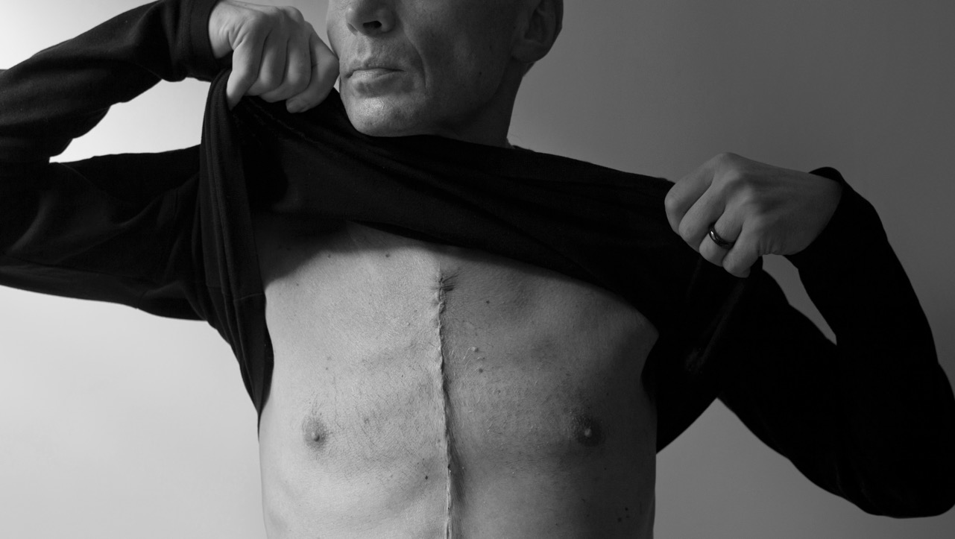

Slide 27
Independent Audit of PleuraFlow® Cost-Benefit
Independent & Peer Reviewed Publication
of US Hospital Analysis of Cost-Benefit Per Patient of PleuraFlow Use (CMC,
Manchester, NH)
Cost-Benefit driven by fewer re-operations, less transfusion, reduced CXR, less lab-work, shorter vent.time and overall significant decrease in LoS and readmissions
complication
reduction
P value
Post-Operative Atrial Fibrillation
Post-Operative Length of Stay (LOS) Pleural Interventions - Percutaneous Retained Blood Composite
32.4%
1 day
63.2%
58.3%
P = 0.011
P < 0.001
P < 0.001
P < 0.001
Mean cost reduction through discharge
$2,696
per patient
Includes the cost of 1.2 PleuraFlow" ACT" Systems per patient
Notes:
something missing before-
sequence off
sticks out. Just an example of another hospital and doesn’t fit well in hospital specific.
TM: agree…maybe we put in after transition to cost analysis slide 18…title: “Peer-Reviewed audit of investment value from use of Active Clearance”

Slide 28
TRACK CARDIOTHORACIC SURGERY DRGS
Valve Procedures
CABG Procedures
Transplant & VAD Procedures Procedures
ICD - 10 Code | ICD Description
02QF0ZZ | Repair Aortic Valve, Open Approach
02QG0ZZ | Repair Mitral Valve, Open Approach
02QH0ZZ | Repair Pulmonary Valve, Open Approach
02QJ0ZZ | Repair Tricuspid Valve, Open Approach
027F04Z | Dilation of Aortic Valve with Drug-eluting Intraluminal Device, Open Approach
027F0DZ | Dilation of Aortic Valve with Intraluminal Device, Open Approach
027F0ZZ | Dilation of Aortic Valve, Open Approach
02NF0ZZ | Release Aortic Valve, Open Approach
02QF0ZZ | Repair Aortic Valve, Open Approach
027G04Z | Dilation of Mitral Valve with Drug-eluting Intraluminal Device, Open Approach
027G0DZ | Dilation of Mitral Valve with Intraluminal Device, Open Approach
027G0ZZ | Dilation of Mitral Valve, Open Approach
02NG0ZZ | Release Mitral Valve, Open Approach
02QG0ZZ | Repair Mitral Valve, Open Approach
027HO4Z | Dilation of Pulmonary Valve with Drug-eluting Intraluminal Device, Open Approach
027H0DZ | Dilation of Pulmonary Valve with Intraluminal Device, Open Approach
027H0ZZ | Dilation of Pulmonary Valve, Open Approach
02NH0ZZ | Release Pulmonary Valve, Open Approach
02QH0ZZ | Repair Pulmonary Valve, Open Approach
027JO4Z | Dilation of Tricuspid Valve with Drug-eluting Intraluminal Device, Open Approach
027J0DZ | Dilation of Tricuspid Valve with Intraluminal Device, Open Approach
ICD - 10 Code | ICD Description
02700ZZ | Dilation of Coronary Artery, One Site, Open Approach
02710ZZ | Dilation of Coronary Artery, Two Sites, Open Approach
02720ZZ | Dilation of Coronary Artery, Three Sites, Open Approach
02730ZZ | Dilation of Coronary Artery, Four or More Sites, Open Approach
02C00ZZ | Extirpation of Matter from Coronary Artery, One Site, Open Approach
02C10ZZ | Extirpation of Matter from Coronary Artery, Two Sites, Open Approach
02C20ZZ | Extirpation of Matter from Coronary Artery, Three Sites, Open Approach
02C30ZZ | Extirpation of Matter from Coronary Artery, Four or More Sites, Open Approach
02C04ZZ | Extirpation of Matter from Coronary Artery, One Site, Percutaneous Endoscopic Approach
02C14ZZ | Extirpation of Matter from Coronary Artery, Two Sites, Percutaneous Endoscopic Approach
02C24ZZ | Extirpation of Matter from Coronary Artery, Three Sites, Percutaneous Endoscopic Approach
02C34ZZ | Extirpation of Matter from Coronary Artery, Four or More Sites, Percutaneous Endoscopic Approach
210093 | Bypass Coronary Artery, One Site from Coronary Artery with Autologous Venous Tissue, Open Approach
02100A3 | Bypass Coronary Artery, One Site from Coronary Artery with Autologous Arterial Tissue, Open Approach
02100J3 | Bypass Coronary Artery, One Site from Coronary Artery with Synthetic Substitute, Open Approach
02100K3 | Bypass Coronary Artery, One Site from Coronary Artery with Nonautologous Tissue Substitute, Open Approach
ICD - 10 Code | ICD Description
02YA0Z0 | Transplantation of Heart, Allogeneic, Open Approach
02YA0Z1 | Transplantation of Heart, Syngeneic, Open Approach
02YA0Z2 | Transplantation of Heart, Zooplastic, Open Approach
02HA0QZ | Insertion of Implantable Heart Assist System into Heart, Open Approach
02HA4QZ | Insertion of Implantable Heart Assist System into Heart, Percutaneous Endoscopic Approach
02WA0JZ | Revision of Synthetic Substitute in Heart, Open Approach
02RK0JZ AND 02RL0JZ | Replacement of Right Ventricle with Synthetic Substitute, Open Approach AND Replacement of Left Ventricle with Synthetic Substitute, Open Approach
02WA0QZ | Revision of Implantable Heart Assist System in Heart, Open Approach
02WA4QZ | Revision of Implantable Heart Assist System in Heart, Percutaneous Endoscopic Approach
02PA0QZ | Removal of Implantable Heart Assist System from Heart, Open Approach
02PA4QZ | Removal of Implantable Heart Assist System from Heart, Percutaneous Endoscopic Approach
02HA0RS | Insertion of Biventricular External Heart Assist System into Heart, Open Approach
02HA4RS | Insertion of Biventricular External Heart Assist System into Heart, Percutaneous Endoscopic Approach

Slide 29
Track ICD-10 Codes for RBS Reinterventions
Short Name | ICD - 10 Code | ICD Description
Pericardiotomy | 02CN0ZZ | Extirpation of Matter from Pericardium, Open Approach
 | 02CN3ZZ | Extirpation of Matter from Pericardium, Percutaneous Approach
 | 02CN4ZZ | Extirpation of Matter from Pericardium, Percutaneous Endoscopic Approach
 | 02NN0ZZ | Release Pericardium, Open Approach
 | 02NN3ZZ | Release Pericardium, Percutaneous Approach
 | 02NN4ZZ | Release Pericardium, Percutaneous Endoscopic Approach
 | 0W9D00Z | Drainage of Pericardial Cavity with Drainage Device, Open Approach
 | 0W9D0ZX | Drainage of Pericardial Cavity, Open Approach, Diagnostic
 | 0W9D0ZZ | Drainage of Pericardial Cavity, Open Approach
 | 0WCD0ZZ | Extirpation of Matter from Pericardial Cavity, Open Approach
 | 0WCD3ZZ | Extirpation of Matter from Pericardial Cavity, Percutaneous Approach
 | 0WCD4ZZ | Extirpation of Matter from Pericardial Cavity, Percutaneous Endoscopic Approach
Thoracentesis | 0W993ZZ | Drainage of Right Pleural Cavity, Percutaneous Approach
 | 0W9B3ZZ | Drainage of Left Pleural Cavity, Percutaneous Approach
Insertion of intercostal catheter for drainage | 0W9930Z | Drainage of Right Pleural Cavity with Drainage Device, Percutaneous Approach
 | 0W9940Z | Drainage of Right Pleural Cavity with Drainage Device, Percutaneous Endoscopic Approach
 | 0W9B30Z | Drainage of Left Pleural Cavity with Drainage Device, Percutaneous Approach
 | 0W9B40Z | Drainage of Left Pleural Cavity with Drainage Device, Percutaneous Endoscopic Approach
Reopening of recent thoracotomy site | 0W390ZZ | Control Bleeding in Right Pleural Cavity, Open Approach
 | 0W3B0ZZ | Control Bleeding in Left Pleural Cavity, Open Approach
 | 0W3D0ZZ | Control Bleeding in Pericardial Cavity, Open Approach
Short Name | ICD - 10 Code | ICD Description
Pericardiocentesis | 0W9D30Z | Drainage of Pericardial Cavity with Drainage Device, Percutaneous Approach
 | 0W9D3ZX | Drainage of Pericardial Cavity, Percutaneous Approach, Diagnostic
 | 0W9D3ZZ | Drainage of Pericardial Cavity, Percutaneous Approach
 | 0W9D40Z | Drainage of Pericardial Cavity with Drainage Device, Percutaneous Endoscopic Approach
 | 0W9D4ZX | Drainage of Pericardial Cavity, Percutaneous Endoscopic Approach, Diagnostic
 | 0W9D4ZZ | Drainage of Pericardial Cavity, Percutaneous Endoscopic Approach
Other incision of pleura | 0B9N00Z | Drainage of Right Pleura with Drainage Device, Open Approach
 | 0B9N0ZZ | Drainage of Right Pleura, Open Approach
 | 0B9N30Z | Drainage of Right Pleura with Drainage Device, Percutaneous Approach
 | 0B9P00Z | Drainage of Left Pleura with Drainage Device, Open Approach
 | 0B9P0ZZ | Drainage of Left Pleura, Open Approach
 | 0B9P00Z | Drainage of Left Pleura with Drainage Device, Percutaneous Approach
 | 0B9N30Z | Drainage of Right Pleural Cavity with Drainage Device, Open Approach
 | 0W9900Z | Drainage of Right Pleural Cavity, Open Approach
 | 0W990ZZ | Drainage of Right Pleural Cavity, Percutaneous Endoscopic Approach
 | 0W994ZZ | Drainage of Left Pleural Cavity with Drainage Device, Open Approach
 | 0W9B00Z | Drainage of Left Pleural Cavity, Open Approach
 | 0W9B4ZZ | Drainage of Left Pleural Cavity, Percutaneous Endoscopic Approach
 | 0WC90ZZ | Extirpation of Matter from Right Pleural Cavity, Open Approach
 | 0WC93ZZ | Extirpation of Matter from Right Pleural Cavity, Percutaneous Approach
 | 0WC94ZZ | Extirpation of Matter from Right Pleural Cavity, Percutaneous Endoscopic Approach
 | 0WCB0ZZ | Extirpation of Matter from Left Pleural Cavity, Open Approach
 | 0WCB3ZZ | Extirpation of Matter from Left Pleural Cavity, Percutaneous Approach
 | 0WCB4ZZ | Extirpation of Matter from Left Pleural Cavity, Percutaneous Endoscopic Approach
Incision of mediastinum | 0W9C00Z | Drainage of Mediastinum with Drainage Device, Open Approach
 | 0W9C0ZZ | Drainage of Mediastinum, Open Approach
 | 0W9C30Z | Drainage of Mediastinum with Drainage Device, Percutaneous Approach
 | 0W9C3ZZ | Drainage of Mediastinum, Percutaneous Approach
 | 0W9C40Z | Drainage of Mediastinum with Drainage Device, Percutaneous Endoscopic Approach
 | 0W9C4ZZ | Drainage of Mediastinum, Percutaneous Endoscopic Approach
 | 0WCC0ZZ | Extirpation of Matter from Mediastinum, Open Approach
 | 0WCC3ZZ | Extirpation of Matter from Mediastinum, Percutaneous Approach
 | 0WCC4ZZ | Extirpation of Matter from Mediastinum, Percutaneous Endoscopic Approach
Notes:
ML176-A

Slide 30
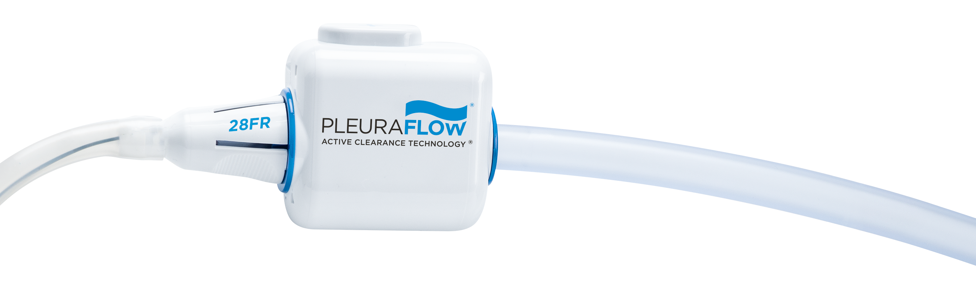
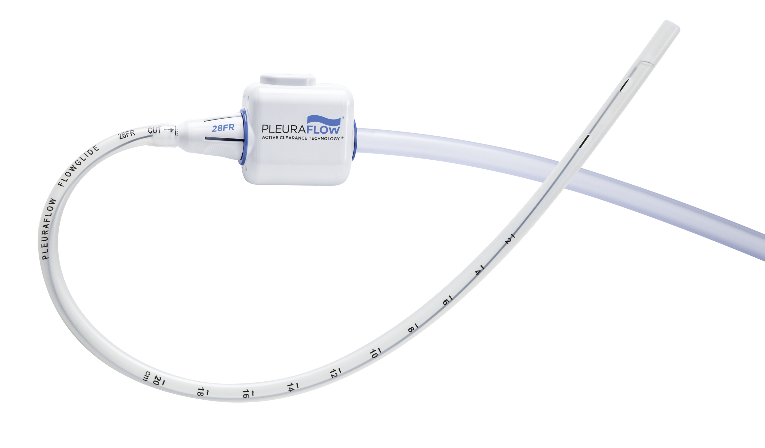
AVAILABLE IN VARIOUS SIZES & CONFIGURATIONS
  Straight
  20, 24, 28, 32 FR
  Right Angle (RA)
  24, 28, 32 FR
  Long (XDL)
  20, 24 FR
As with selection and placement of any chest tube, care must be taken to ensure that the tube drainage eyelets remain contained within the chest cavity for the duration of application.
Notes:
The PleuraFlow ACT System is available in various sizes and configurations.

